Slide 1
UI and UX

Slide 2
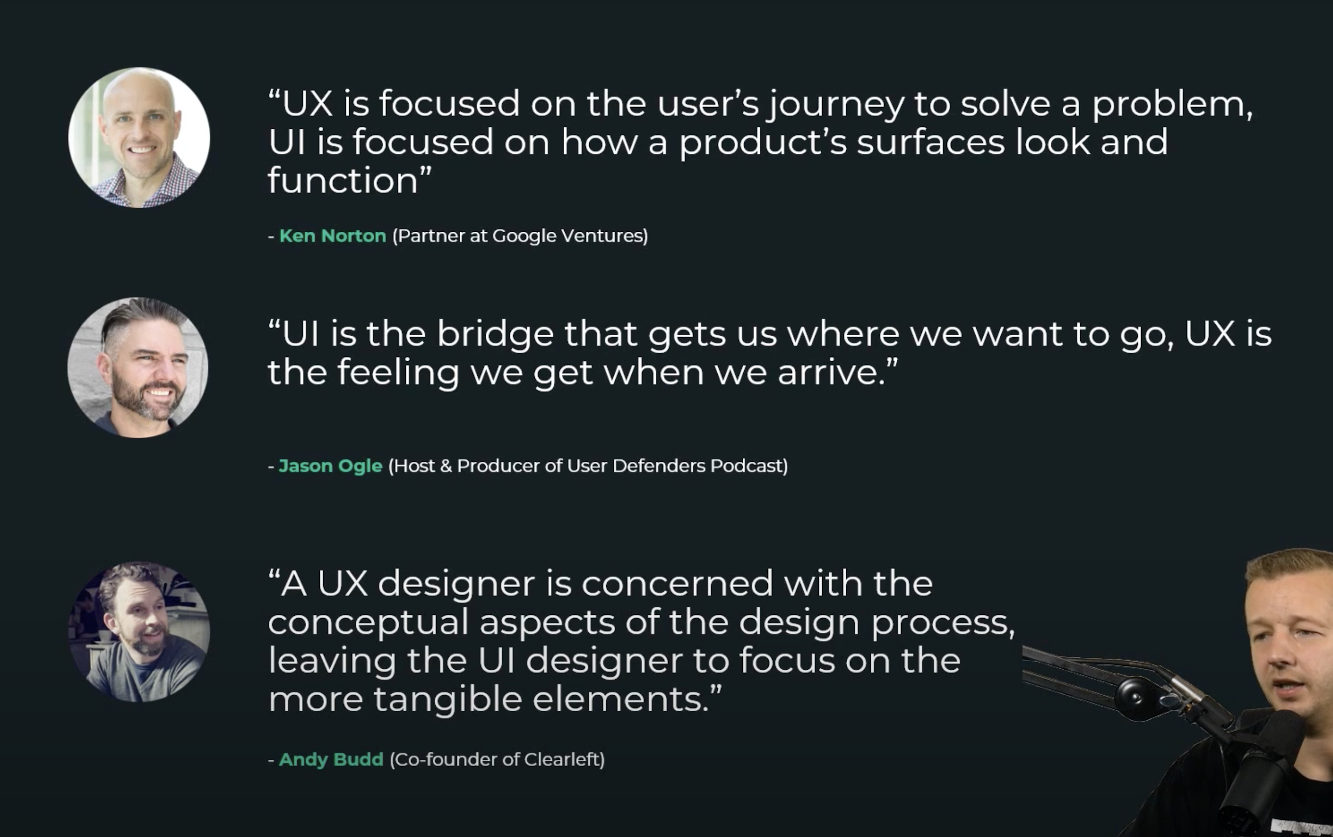

Slide 3
Everything we need right now.
At least 3 separate pages
Discover page - find posts from other creators. (algorithm only used here)
Following page - Users who you follow but do not follow you back ( primarily used to follow big creators and celebrities ( could potentially also be used to see if your friends unfollowed you)
Friends page - posts from users that follow you back.
*placed like the following and for you page on the top of tik tok

Slide 4
Everything we need right now.
Dms
Ability to like
Ability to comment
The tier system
Ability to save the photo
Settings
Profile
TAKING THE PHOTO

